Slide 1

Session 6
Linear Programming – Transportation
Big Data and Analytics
Topic 6: Classification
We will wait for 5 to 10 mins for everyone to join

Slide 2

Recap
Linear Programming – Transportation
What we discussed last week?

Slide 3
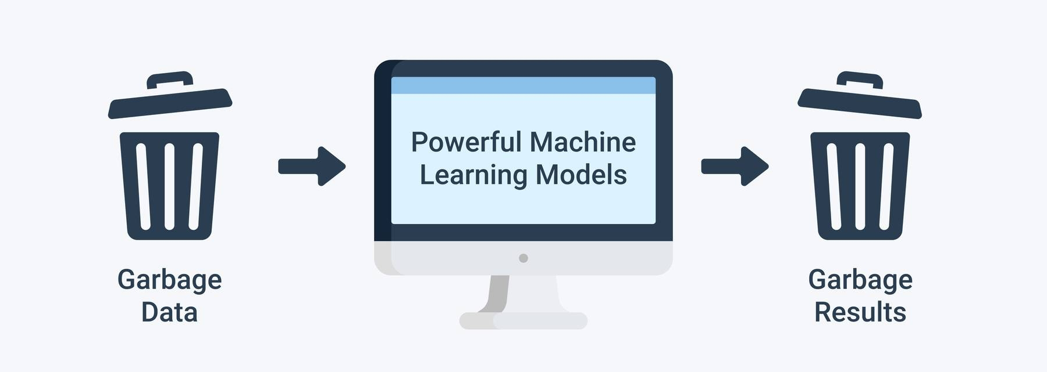
Recap: Data Exploration and Cleaning
Garbage in, Garbage out
Notes:
All decisions are based on data, if you don’t clean and prepare the data, the decisions will be based on something which is not right.

Slide 4
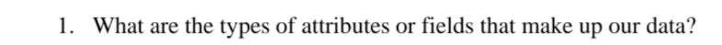
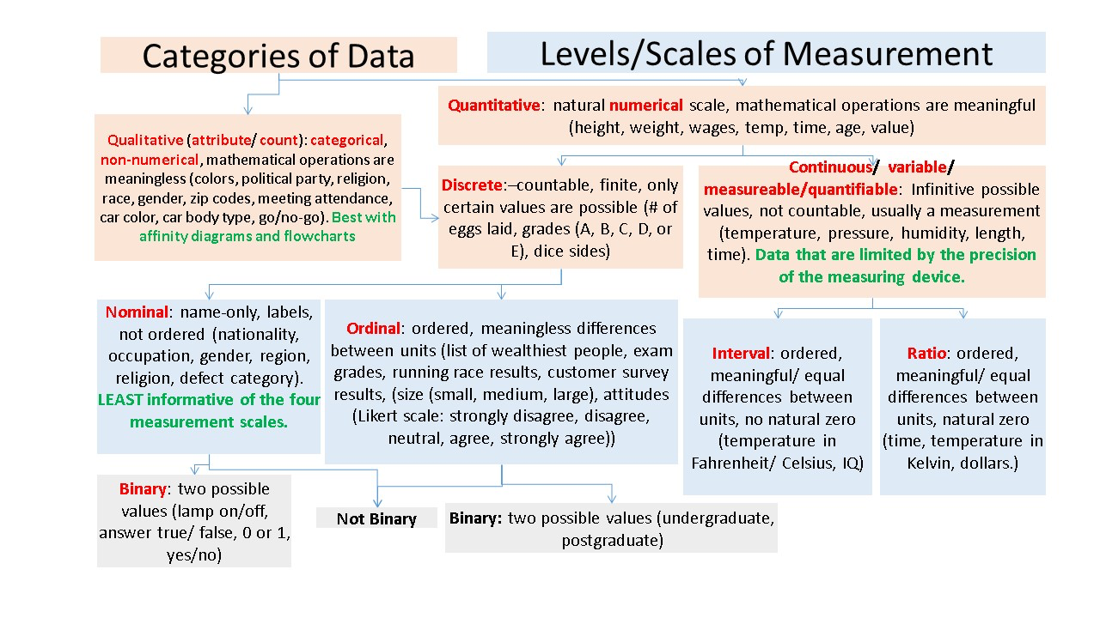
Recap: Data Exploration and Cleaning
Nominal
Binary
Ordinal
Numeric
Notes:
source of picture:https://stats.stackexchange.com/questions/159902/is-nominal-ordinal-binary-for-quantitative-data-qualitative-data-or-both

Slide 5

Recap: Data Exploration and Cleaning
Nominal attributes have values that represent different categories or labels (e.g., colours, types of fruits).
Binary attributes typically have values like 0 and 1, True and False, or Yes and No.
Ordinal attributes have values that can be ranked or ordered (e.g., low, medium, high).
Interval attributes have numeric values with consistent differences between them but no true zero (e.g., temperature in Celsius).
Ratio attributes have numeric values with a consistent interval and a true zero point (e.g., height, weight).

Slide 6
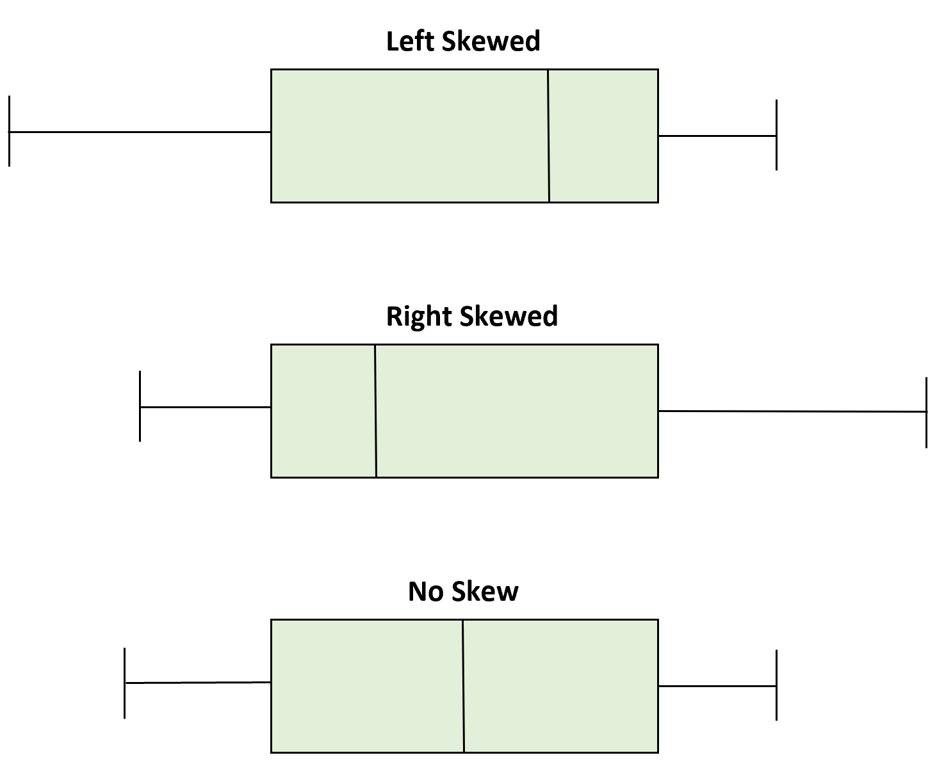
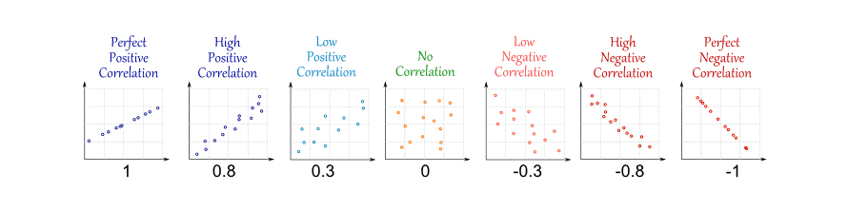
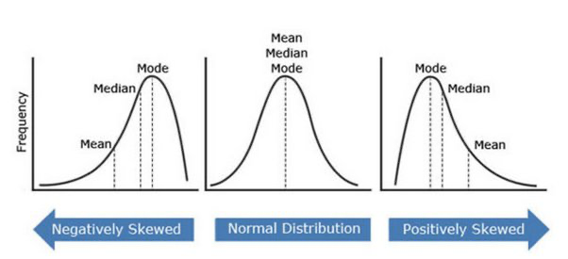
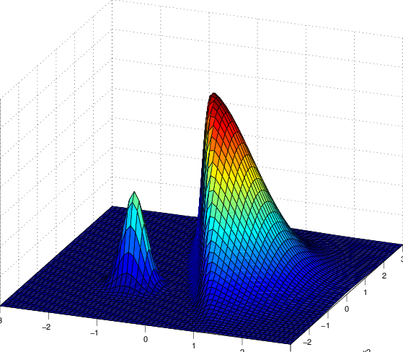
Recap: Data Exploration and Cleaning

Slide 7
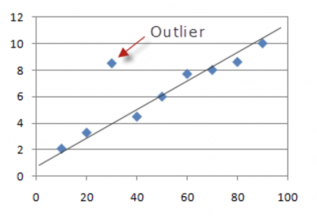
Recap: Data Exploration and Cleaning
Outliers or anomalies can often be identified using visual tools like box plots, where points outside the "whiskers" might be considered outliers.
Statistical methods like z-scores can be used to detect outliers.

Slide 8
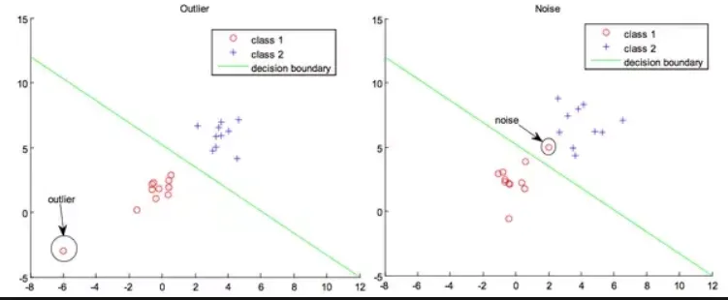
Recap: Data Exploration and Cleaning
Dealing with Noisy Data and Outliers

Slide 9
Recap: Data Exploration and Cleaning
Dealing with Missing Values
Dealing with Noisy Data
Dealing with Outliers
Standardising VS Normalisation
Dealing with duplicated data
Notes:
Dealing with missing values is a crucial aspect of data cleaning, as missing values can introduce bias or reduce the statistical power of a dataset. Several techniques can be employed to handle them:

Slide 10
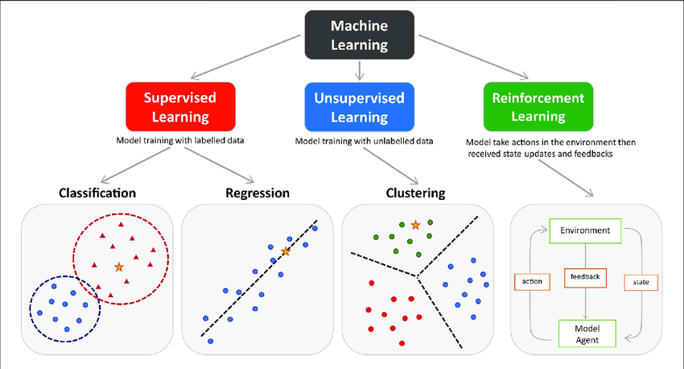
Supervised and Unsupervised Machine Learning
Supervised machine learning is generally used to classify data or make predictions, whereas unsupervised learning is generally used to understand relationships within datasets.
Supervised machine learning is much more resource-intensive because of the need for labelled data.
Notes:
Image source:https://www.researchgate.net/publication/354960266_Machine_Learning_Techniques_for_Personalised_Medicine_Approaches_in_Immune-Mediated_Chronic_Inflammatory_Diseases_Applications_and_Challenges

Slide 11
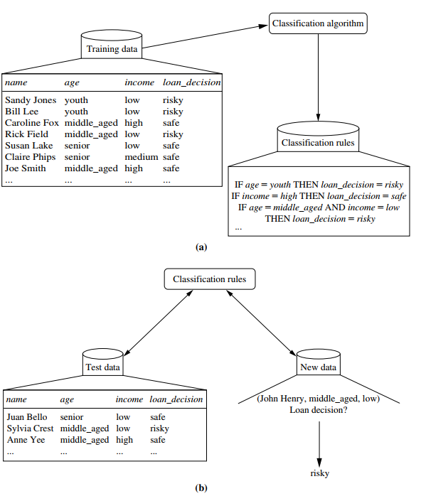
Supervised and Unsupervised ML
Because the class label of each training tuple is provided, this step is also known as supervised learning.
with unsupervised learning (or clustering), in which the class label of each training tuple is not known, and the number or set of classes to be learned may not be known in advance. For example, if we did not have the loan decision data available for the training set, we could use clustering to try to determine “groups of like tuples,” which may correspond to risk groups within the loan application data

Slide 12
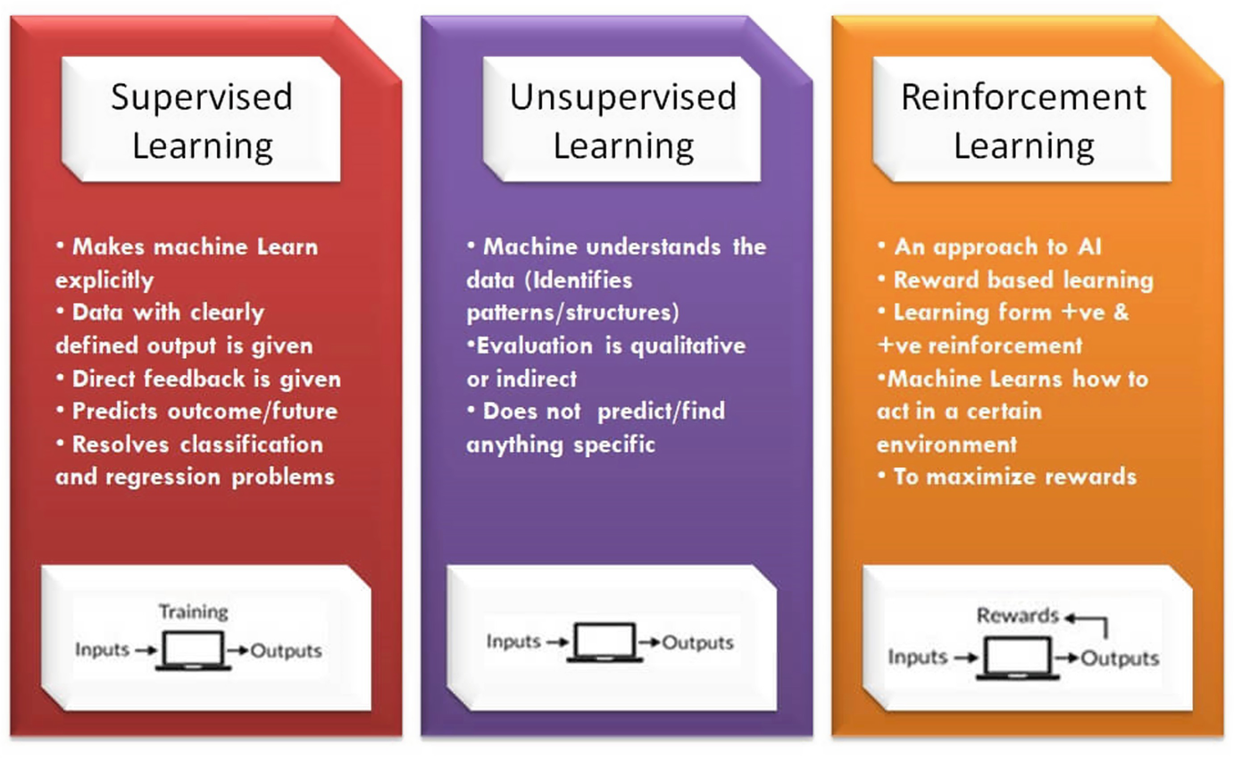
Supervised and Unsupervised Machine Learning
Source: Analytics Yogi

Slide 13
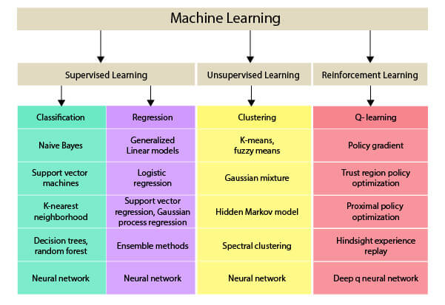
Supervised and Unsupervised Machine Learning
Some popular machine learning methods:
Source: NimbleBox.ai

Slide 14
Supervised and Unsupervised Machine Learning
Some popular machine learning methods:
Source: NimbleBox.ai

Slide 15
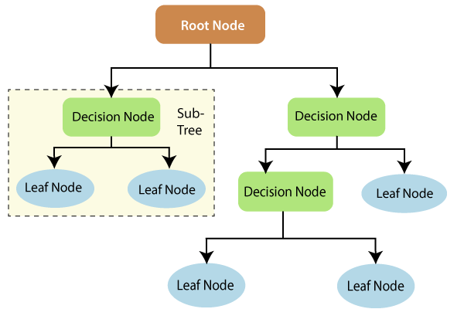
Introduction to Decision Trees
Some popular machine learning methods:
A Decision Tree is a flowchart-like structure in which each internal node represents a feature(or attribute), each branch represents a decision rule, and each leaf node represents an outcome.
Structure of a Decision Tree:
Root Node: It represents the entire population or sample. It further gets divided into two or more homogeneous sets.
Decision Node: When a sub-node splits into further sub-nodes, then it is called the decision node.
Leaf/Terminal Node: Nodes that do not split are called Leaf or Terminal nodes.
Pruning: The process of removing the unwanted branches from the tree.
Source: Imakash3011.medium.com
Notes:
Real-world analogy: Think of playing the game "20 Questions." You ask a series of questions to arrive at an answer. Similarly, the decision tree asks a series of questions about the data to arrive at a decision or prediction.

Slide 16
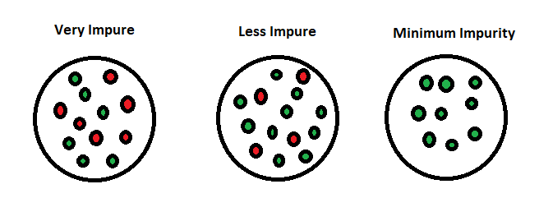
Introduction to Decision Trees
How Decision Trees Work:
Choosing a feature to split on: This involves selecting the best feature to split on using a criterion like entropy, gini impurity, or information gain.
Entropy: A measure of the randomness or unpredictability in the dataset.
Gini Impurity: A measure of frequency at which any element is misclassified.
Information Gain: The entropy of the dataset before the split minus the weighted entropy of each branch after the split.
Splitting: The dataset is split according to the chosen feature's value. This process is repeated recursively, resulting in a tree-like model of decisions.
Stopping conditions: The process stops when a certain depth is reached, when the node contains data from only one class, or when no more information gain is achieved.

Slide 17
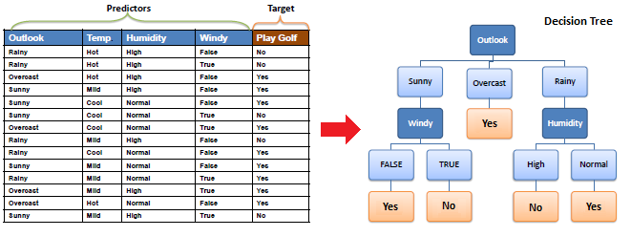
Introduction to Decision Trees – Example 1
Notes:
source:https://www.saedsayad.com/decision_tree.htm

Slide 18
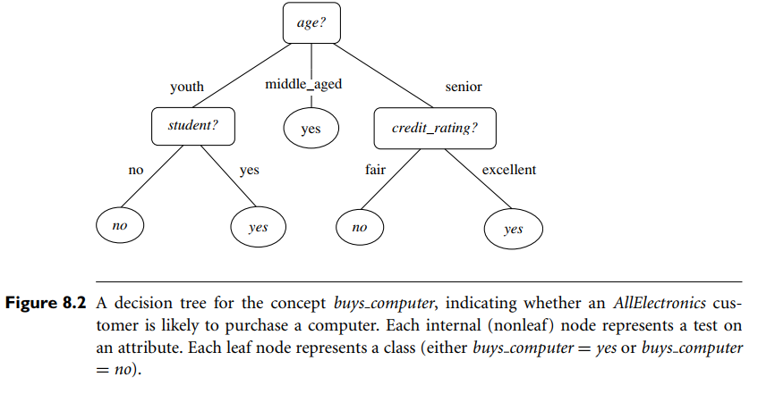
Introduction to Decision Trees- Example 2
Notes:
A typical decision tree is shown in Figure 8.2. It represents the concept buys computer, that is, it predicts whether a customer at AllElectronics is likely to purchase a computer. Internal nodes are denoted by rectangles, and leaf nodes are denoted by ovals. Some decision tree algorithms produce only binary trees (where each internal node branches to exactly two other nodes), whereas others can produce nonbinary trees.

Slide 19
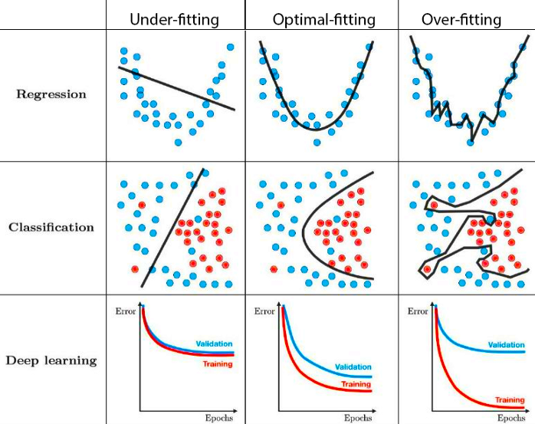
Introduction to Decision Trees
Overfitting:
Underfitting happens when the model has a very high bias and is unable to capture the complex patterns in the data
Overfitting: When the tree is too complex and captures noise rather than the underlying pattern. This means it may perform well on the training data but poorly on unseen data.
Optimal fitting situation where the model has a smaller gap between the training and validation error values
Bias – Assumptions made by a model to make a function easier to learn. Variance – If you train your data on training data and obtain a very low error, upon changing the data and then training the same previous model you experience high error, this is variance.
Notes:
source of picture: towards data science
Underfitting happens when the model has a very high bias and is unable to capture the complex patterns in the data. This leads to higher training and validation errors since the model is not complex enough to classify the underlying data. In the above example, we see that the data has a second-order relation but the model is a linear model so it won’t be able to
Overfitting is the opposite in the sense that the model is too complex (or higher model) and captures even the noise in the data. Therefore in this case one would observe a very low test error value. However, when it would fail to generalise to both the validation and test sets.
We want to find the optimal fitting situation where the model has a smaller gap between the training and validation error values. It should better generalization than in the other two cases.

Slide 20
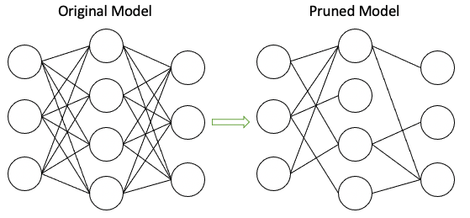
Introduction to Decision Trees
Pruning:
Pruning: A technique to avoid overfitting. It involves removing parts of the tree that do not provide significant power in predicting target values.
Notes:
source of picture: https://towardsdatascience.com/model-compression-via-pruning-ac9b730a7c7b

Slide 21
Introduction to Decision Trees
Advantages and Disadvantages of Decision Trees:
Advantages:
Easy to understand and visualize.
Requires little data preprocessing.
Can handle numerical and categorical data.
Can model non-linear relationships.
Disadvantages:
Prone to overfitting, especially with deep trees.
Can be unstable, as small changes in the data can result in a completely different tree.
Biased with imbalanced datasets.
Notes:
source of picture:

Slide 22
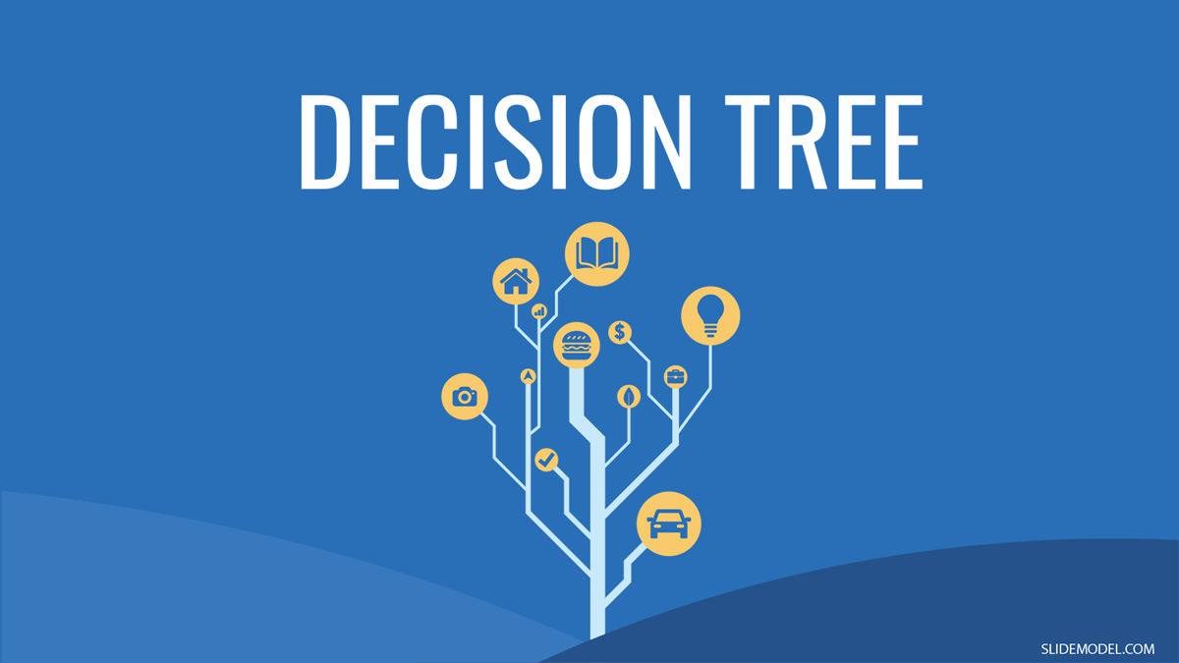
Introduction to Decision Trees
Applications of Decision Trees:
Classification tasks (e.g., determining whether an email is spam or not spam).
Regression tasks (e.g., predicting house prices).
Business decision-making.
Notes:
source of picture:https://slidemodel.com/how-to-incorporate-decision-trees-into-your-presentations/

Slide 23
Real-World Applications of Decision Trees Scenarios
Healthcare: Predicting Disease Outcomes
Case Study: Decision trees have been used to predict diseases like diabetes, heart disease, or cancer based on a variety of patient attributes such as age, gender, blood pressure, cholesterol level, and more.
Importance: Early and accurate prediction of diseases can aid in timely and more efficient treatments, possibly saving lives.
Banking: Credit Scoring
Case Study: Financial institutions use decision trees to assess the creditworthiness of loan applicants. Variables might include income, employment status, credit history, current debt, and more.
Importance: Better credit scoring models reduce the risk of loan defaults, leading to more sustainable lending practices and reduced financial risk for banks.
Retail: Customer Segmentation
Case Study: Retailers use decision trees to classify customers into different segments based on purchase history, browsing behaviour, demographic details, etc.
Importance: Understanding customer segments can help retailers target their marketing efforts more effectively, enhancing sales and customer retention.
Telecommunication: Churn Prediction
Case Study: Telecom companies use decision trees to predict which customers are most likely to switch service providers. Features can include call drop rate, customer complaint history, billing history, etc.
Importance: Reducing churn is essential for telecom companies to maintain profitability. Understanding which customers are at risk allows companies to intervene proactively.
Notes:
Energy: Failure Prediction of Equipment
Case Study: Energy companies, especially those in oil and gas, use decision trees to predict equipment failures based on parameters like temperature, pressure, and historical malfunction data.
Importance: Predicting and addressing equipment malfunctions before they occur can prevent hazardous incidents and save costs.
Public Safety: Crime Prediction
Case Study: Law enforcement agencies use decision trees to classify areas based on crime risk. Variables might include historical crime rates, nearby amenities, population density, and socio-economic factors of the region.
Importance: Identifying high-risk areas can allow law enforcement to allocate resources more efficiently, potentially preventing crimes.
E-commerce: Fraud Detection
Case Study: E-commerce platforms deploy decision trees to detect potentially fraudulent transactions. Features might encompass transaction amount, location, device type, frequency of transactions, etc.
Importance: Detecting and preventing fraud protects both the platform and its users from financial losses and maintains the platform's integrity.
Pharmaceuticals: Drug Analysis
Case Study: Decision trees are used to classify the potential efficacy of new drugs based on clinical trial data.
Importance: By understanding how different attributes can impact drug efficacy, pharmaceutical companies can focus their efforts on the most promising drugs.
Real Estate: Property Valuation
Case Study: Real estate companies use decision trees to classify properties into different price brackets based on features like location, size, age, amenities, and more.
Importance: Accurate property valuation helps buyers, sellers, and investors make informed decisions.
Automotive: Predicting Warranty Claims
Case Study: Automobile manufacturers can use decision trees to predict the likelihood of warranty claims based on vehicle attributes and usage patterns.
Importance: Addressing potential warranty issues proactively can lead to better customer satisfaction and reduced costs for manufacturers.

Slide 24
Break
Linear Programming – Transportation
break (10 mins)
Set Up your Jupyter We will do some coding to explore Data and build a decision tree model

Slide 25
Questions?

